Slide 1
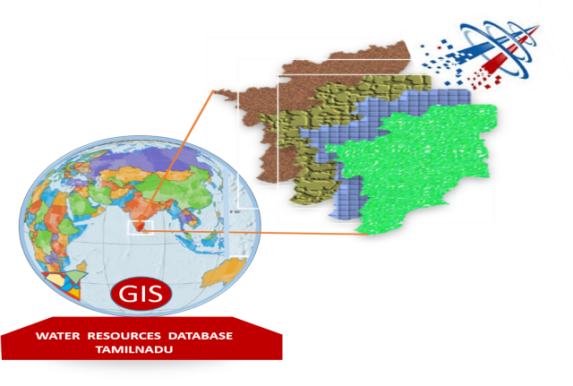
Government of Tamil Nadu
Public Works Department,
Water Resources Department.
www.tnwristn.gov.in
INTEGRATED GIS BASED WEB ENABLED DATA SET FOR WATER STAKE HOLDER DEPARTMENTS - TAMIL NADU
Since 09.06.2011
SECURING WATER FOR
FUTURE

Slide 2
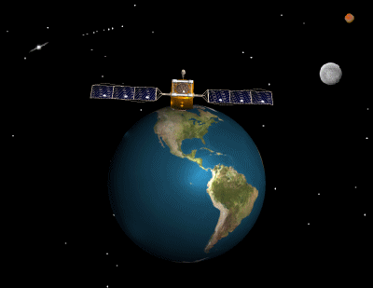
TAMIL NADU
WATER RESOURCES INFORMATION SYSTEM
www.tnwris.gov.in
SWaRMA

Slide 3
TRAINING FOR OFFICERS TO DEVELOP IN-HOUSE IN OPEN GIS, POSTGRE
SQL, POST GIS, GEOSERVER, HTML, JAVASCRIPTING,
PHP, ETC..
CONTINUOUS INTERACTION BY THE DIRECTOR SWaRMA WITH THE TEAM
WEB PORTAL
ONE DAY WORKSHOP BY INVITING GOI, GOAP, NIC, ETC PERSONNELS
GIS TRAINING
WRD OFFICIALS USING
ARC GIS
CREATION OF MODEL WEBSITE & COLLECTION DATA OF DATABASE
STEP BY STEP PROCESS

Slide 4
Architecure of tn wris – VERSION 1
Q GIS

Slide 5
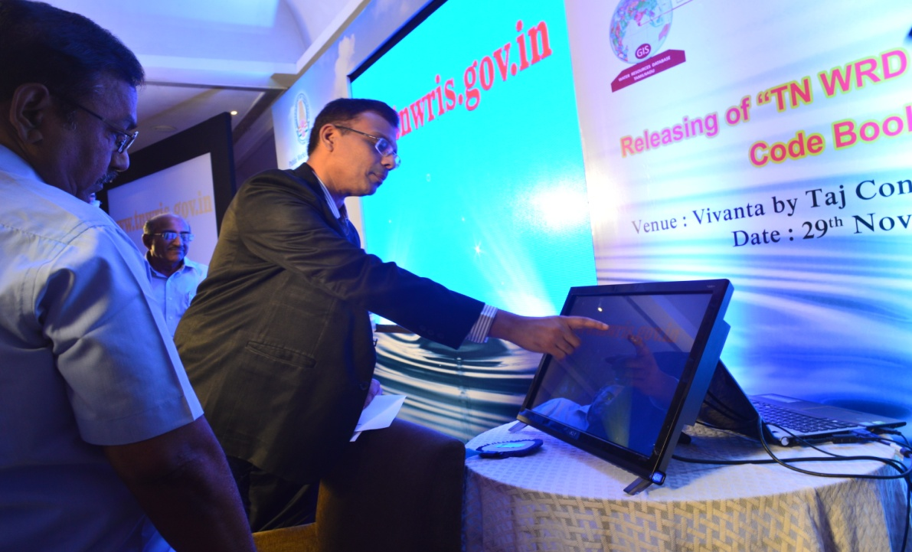
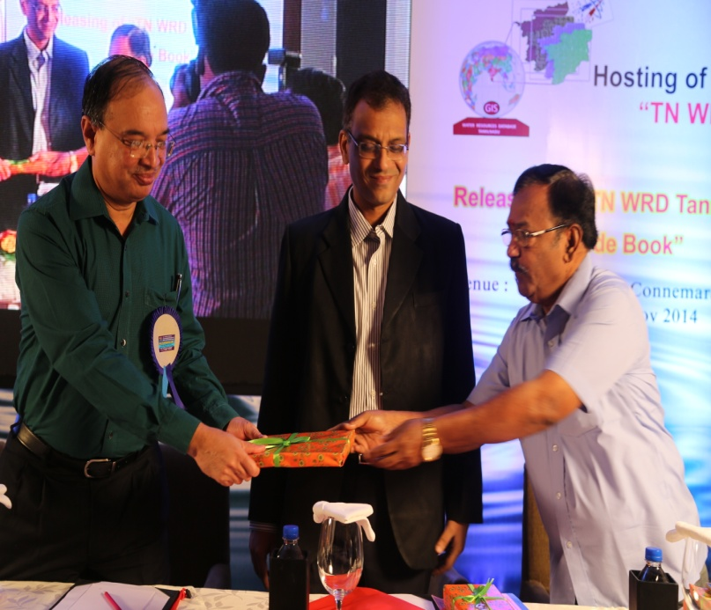
HOSTING OF TNWRIS
www.tnwristn.gov.in
Dedicated on 29.11.2014

Slide 6
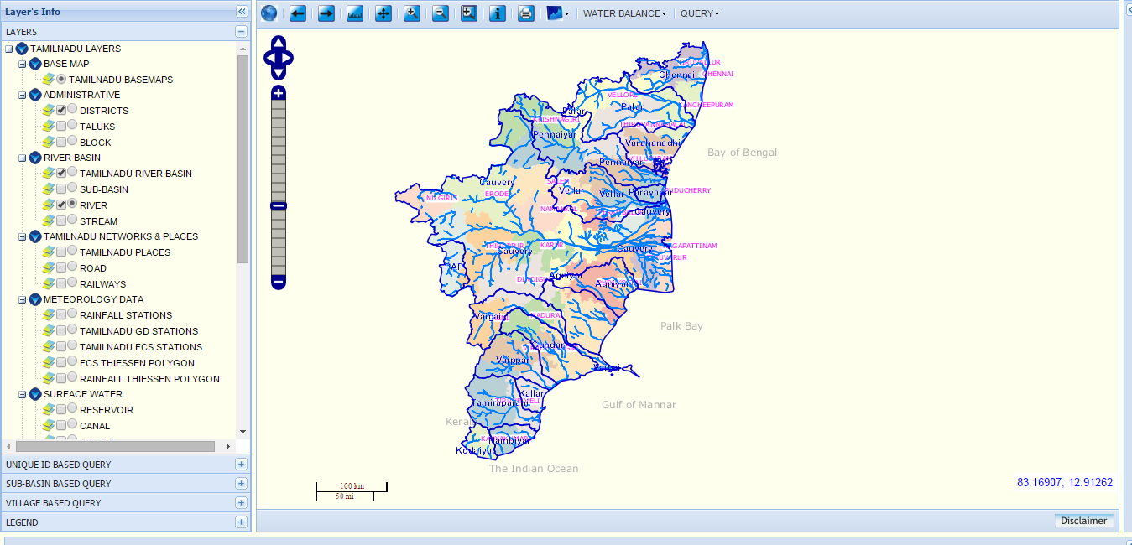
tnwris – NON SPATIal
tnwris –SPATIal

Slide 7
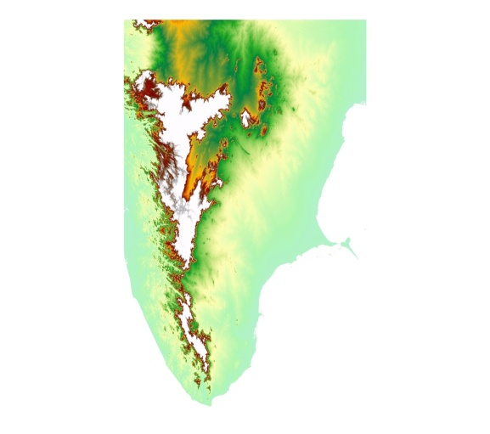
GIS TRAINING
Based on the initiation taken by SWaRMA, GIS trainings were imparted in phased manner.
37 officers belong to SWaRMA, IWS, SG&SWRDC, EIC office, DRCS and WRD Regions were trained in ARC GIS software.
These River basins and
its sub basin boundaries
Were fine-tuned now in
GIS techniques, utilizing the services of above 20 GIS trained Officers.
1:50,000Topographic maps of SOI, SRTM–DEM elevation
data of USGS were
utilized for fine
tuning the boundaries.

Slide 8
TNWRIS LAYERS
GCS WGS84 - 1:50,000 scale
River Basins - 17 nos.
Sub Basin boundaries - 127nos.
Administrative layers – District, Taluks, Blocks
Rivers , Streams
Landuse
Tanks
GCS WGS84 – 1:2,000 scale
Geology
Geomorphology
Lineaments
INSTITUTE OF WATER
STUDIES, CHENNAI
STATE GROUND AND
SURFACE WATER
RESOURCE DATA
CENTER, CHENNAI
LINE DEPARTMENTS
SOURCE

Slide 9
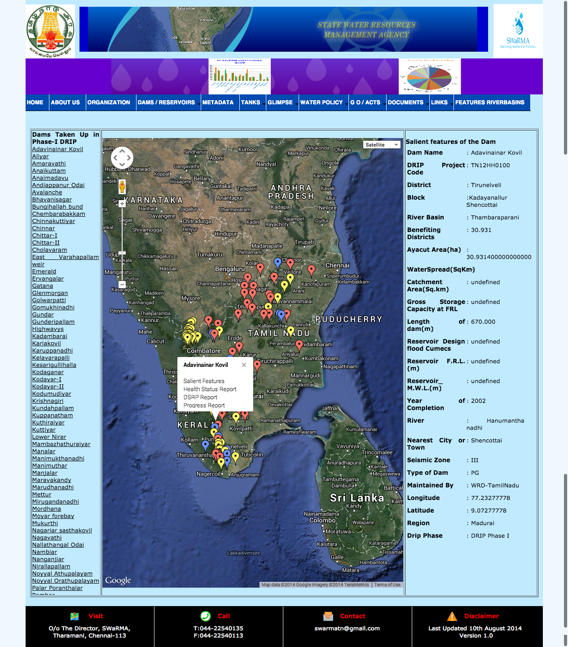
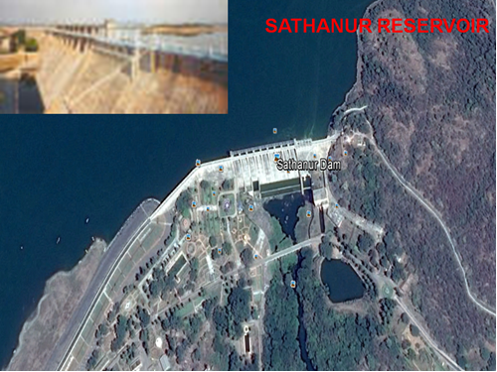
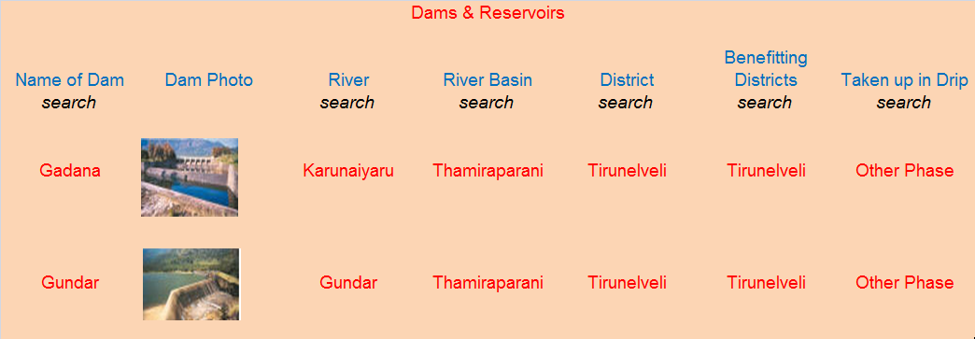
DAMS / RESERVOIRS
Non-spatial

Slide 10
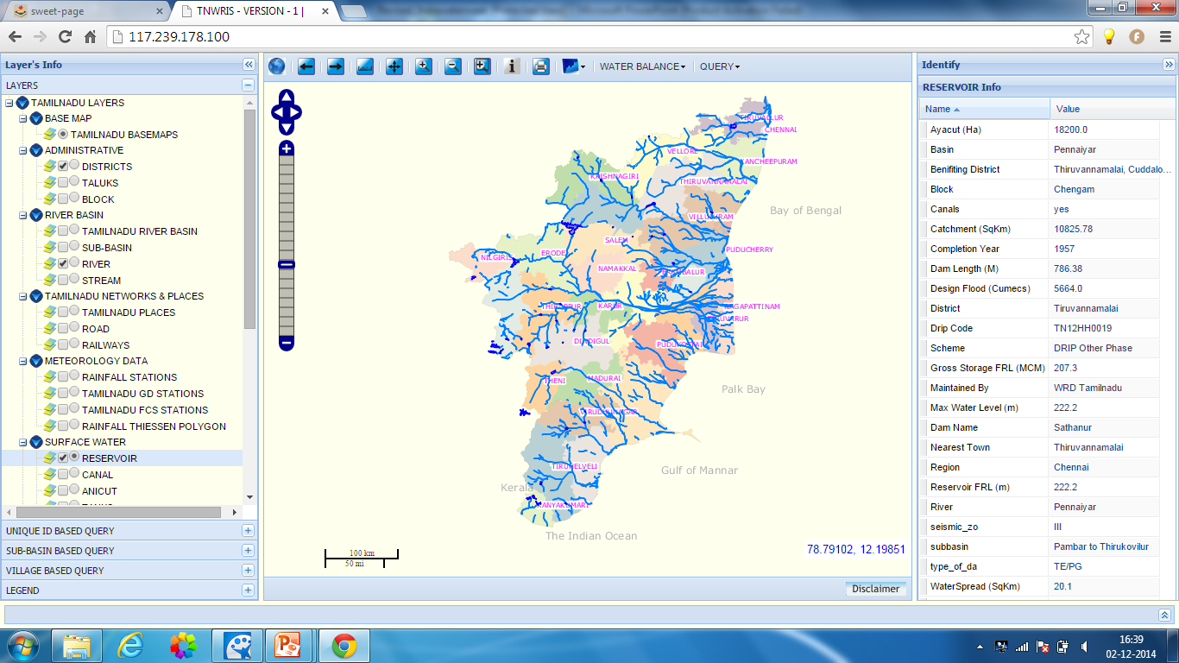
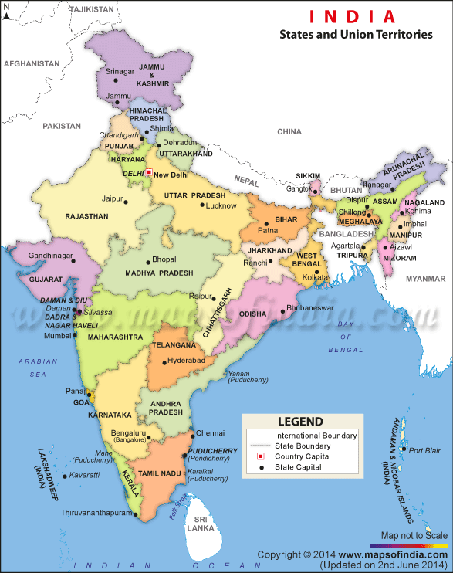
DAMS / RESERVOIRS
N

Slide 11
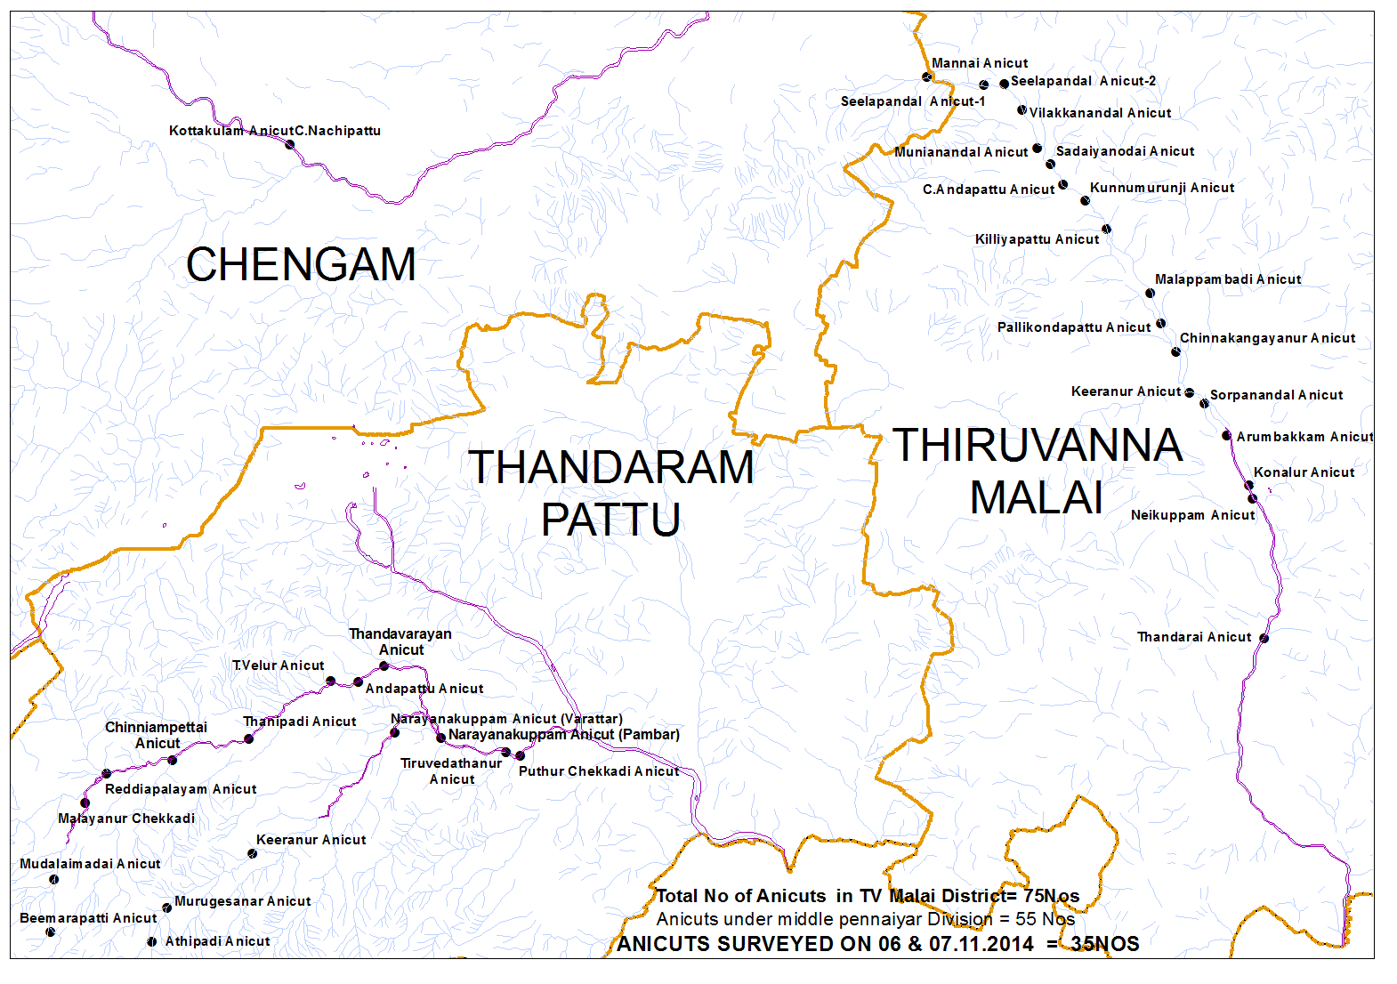
ANICUTS – PENNAIYAR BASIN

Slide 13
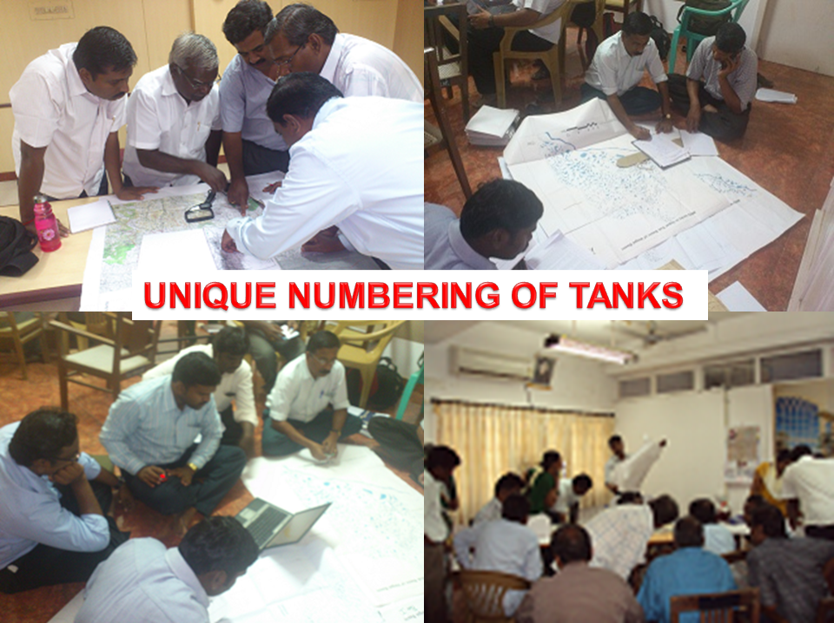
TANKS UNIQUE CODING - AGNIYAR BASIN MAPS
T – Tanks
Tank Number
Sub Basin – 01
Agniyar Basin – AG
Tamil Nadu - TN

Slide 14
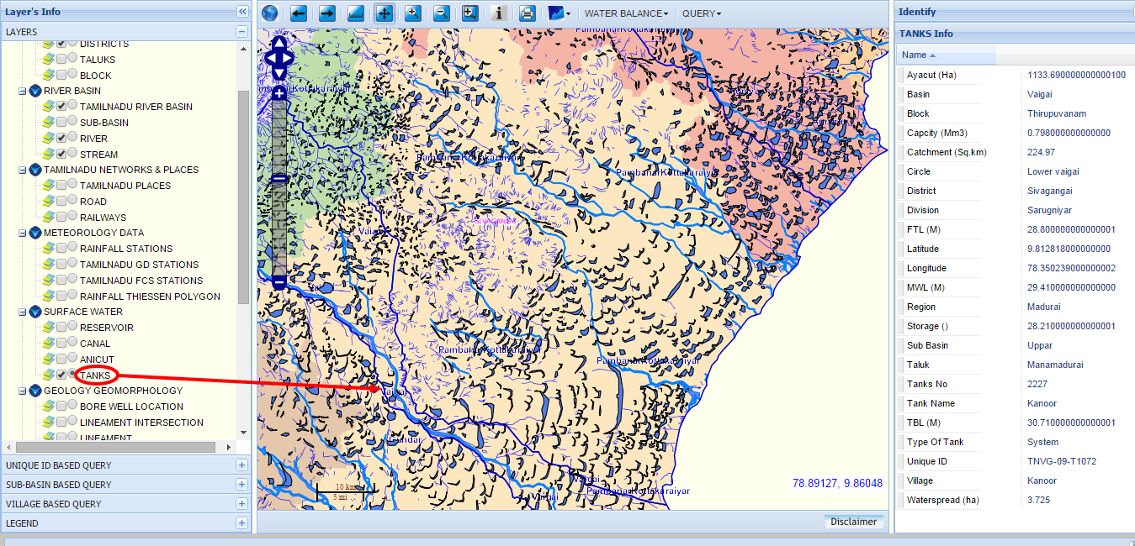
TANKS
N

Slide 15
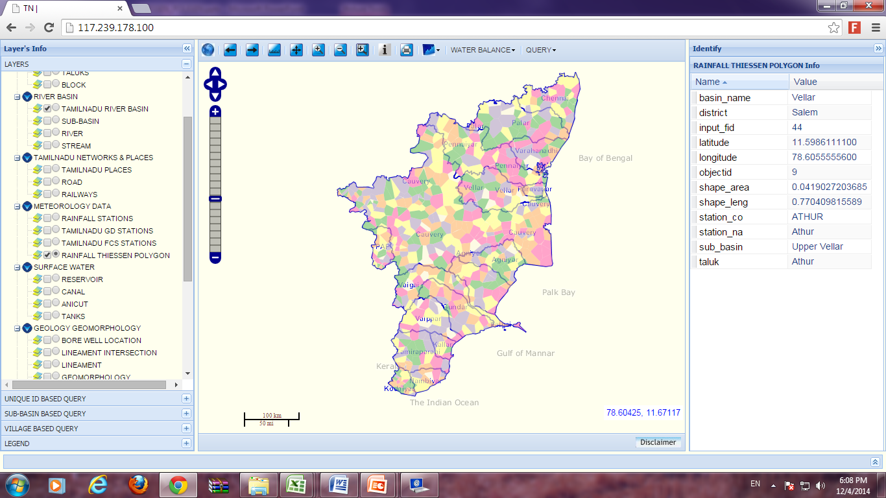
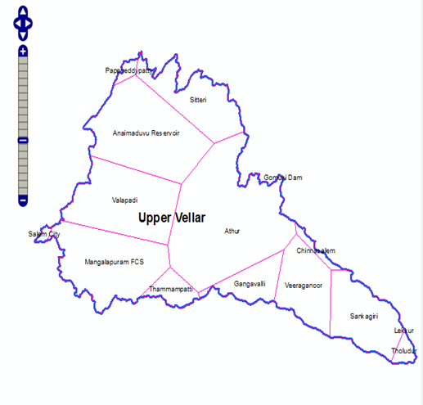
UPPER VELLAR-THIESSEN POLYGON MAP
N
PENNAIYAR
GOMUKHI
LOWER VELLAR
CAUVERY
SWETHA NADHI

Slide 16
Geology Layer Can be used to choose suitable sites for Groundwater Exploration, Artificial Recharge Structures and in building of storage structures etc. Each Geological unit is assigned a rank based their property with regard to water resources.

Slide 17
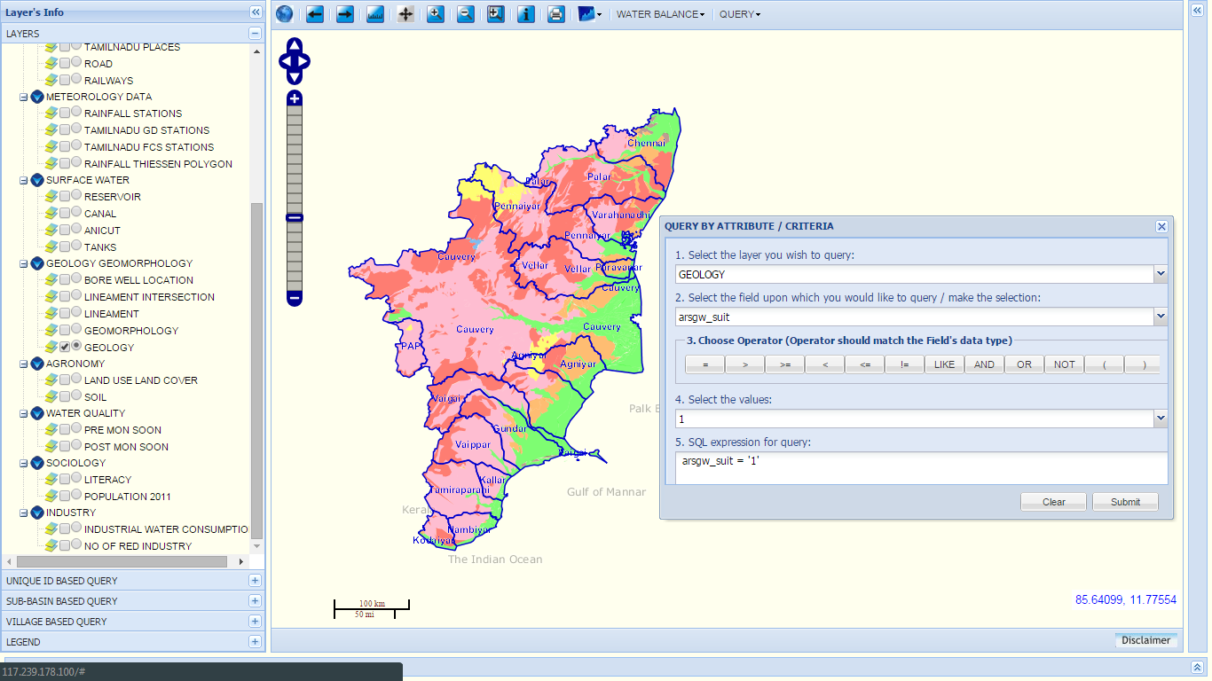
GEOLOGY MAP OF TAMILNADU
N
AndhraPradesh
Bay of Bengal
Karnataka
Kerala
Gulf of mannar
Indian Ocean
80.32910

Slide 18
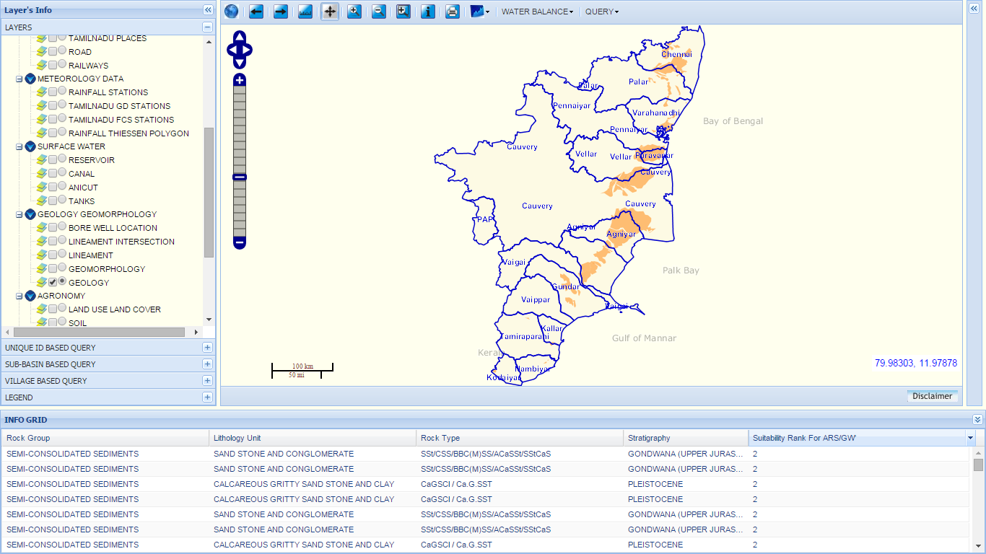
Andhra Pradesh
QUERY ON GEOLOGY MAP OF TAMILNADU
N
Karnataka
Bay of Bengal
Pak Bay
Result of Query
Kerala
Gulf of mannar
Area showing Rank 2

Slide 19
Lineament Layer
Lineaments play vital role in the movement and storage of groundwater. This layer can be considered in groundwater exploration, selecting Artificial Recharge structures and in building storage structures.

Slide 20
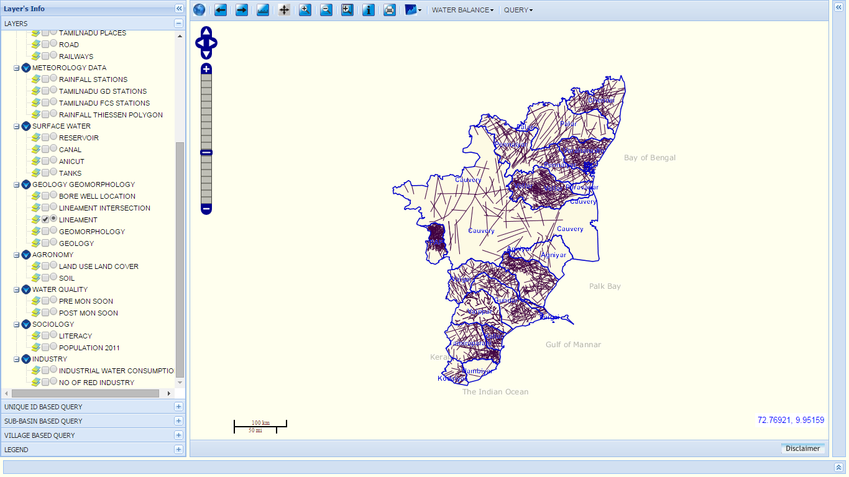
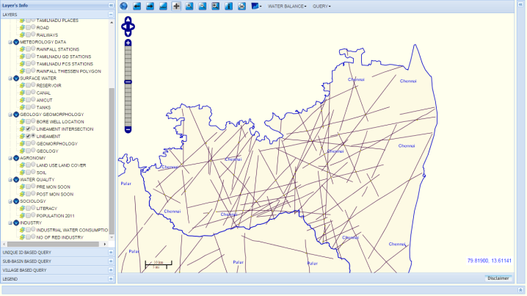
LINEAMENT
N
ChennaiBasin
Andhra Pradesh
Karnataka
Bay of Bengal
Lineament layer overlaid by RiverBasins
Palk Bay
Kerala
Gulf of Mannar
Indian ocean

Slide 21
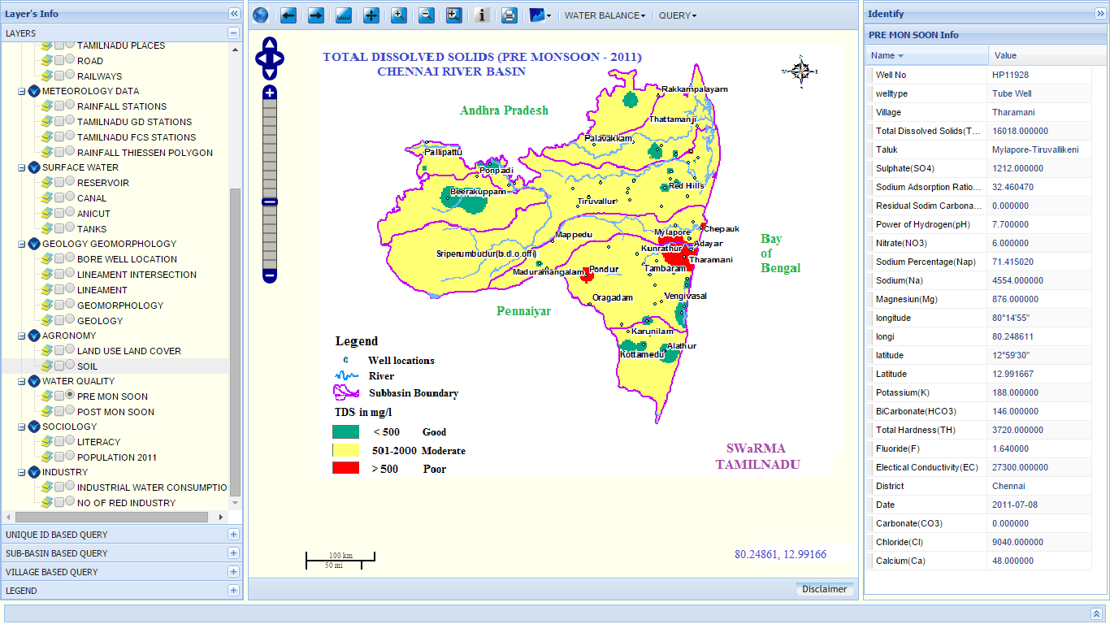

Slide 22
Sub Basin Wise
Water Potential, Sectoral Demand & Water Balance
Spatial Information
Non Spatial
Surface water
Ground Water
Surface water
Ground Water
Potential
Potential
Sectoral Demand- Domestic, Livestock, Irrigation, Industries
Sectoral Demand- Domestic, Livestock, Irrigation, Industries
Water Balance
Water Balance
Outflow to Sea
Charts containing Water potential, Sectoral Demand & Water Balance
Outflow to Sea

Slide 23
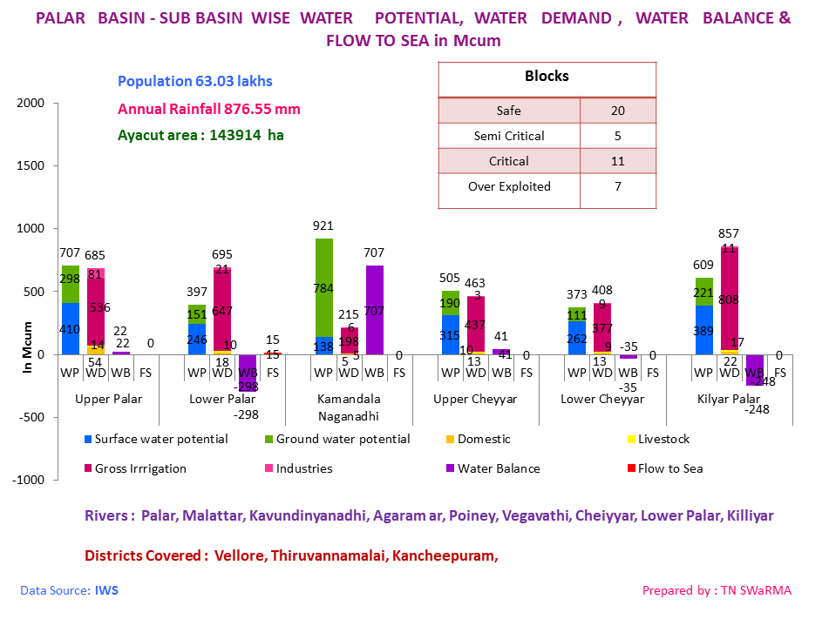

Slide 24
THANK YOU

